Slide 1
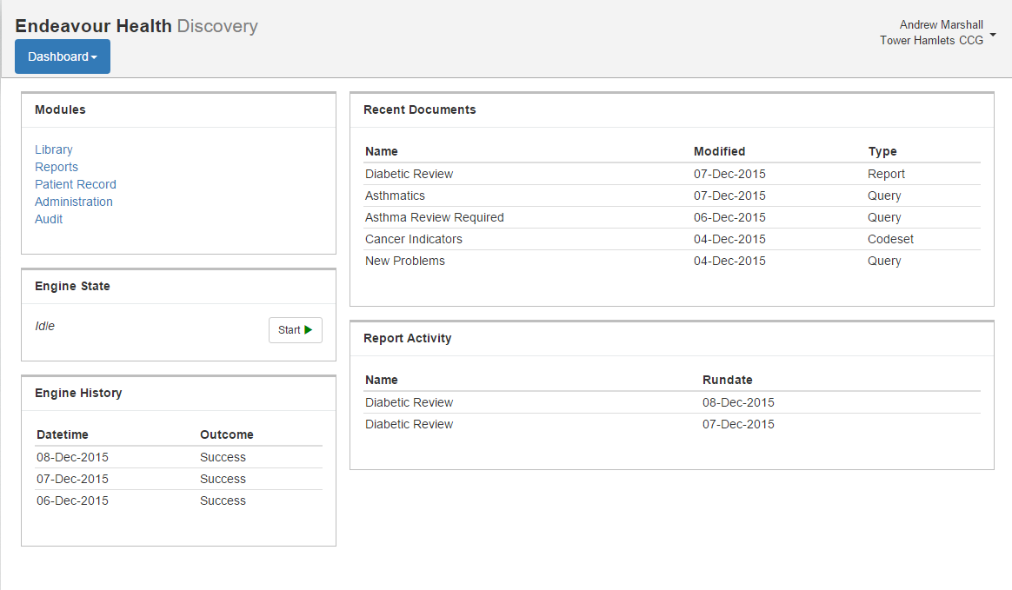

Slide 2
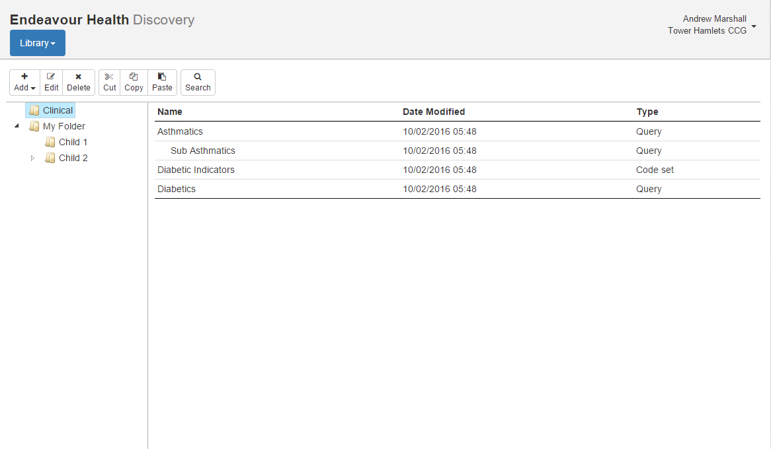

Slide 3
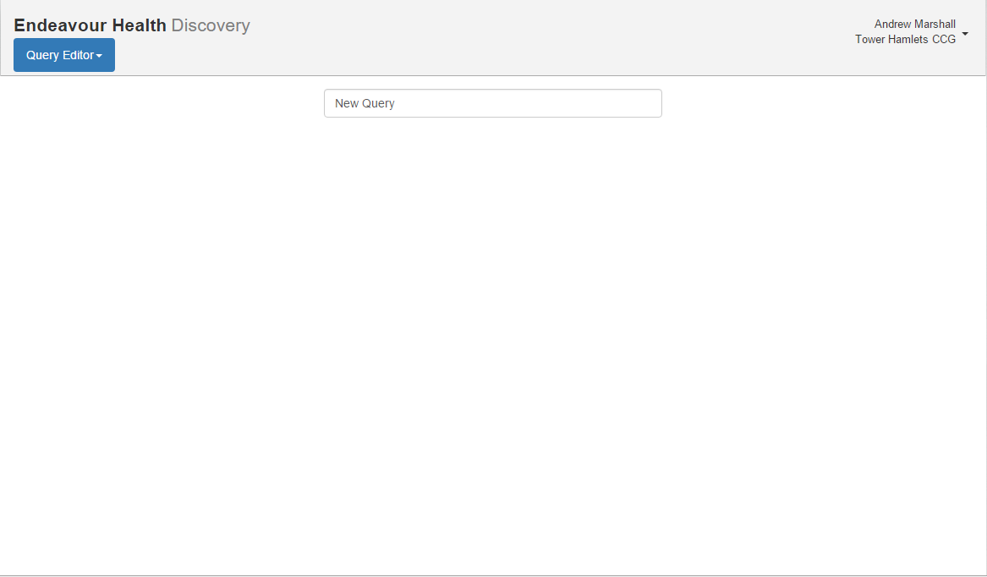
Parent
None
Data Source is Observations
With Clinical Codes of H33%
And Episodicity of First
Data Source is Observations
With Clinical Codes of R132%
And Clinical Date greater than 01-Jan-2015
Test that Count > 3
And
Goto Next
Data Source is Observations
With Clinical Codes of H33%
And Episodicity of First

Slide 4
Data Source
Root
Observations
Test
Filters
Clinical Code is H33%
Episodicity is First
Linked Test
Clinical Date > 01-Jan-2010
Add
Restriction
Add
Cancel
OK

Slide 5
Data Source
Has results
Test
Count results
Passes
Linked Test
Clinical Code is H335
Add
Cancel
OK

Slide 6
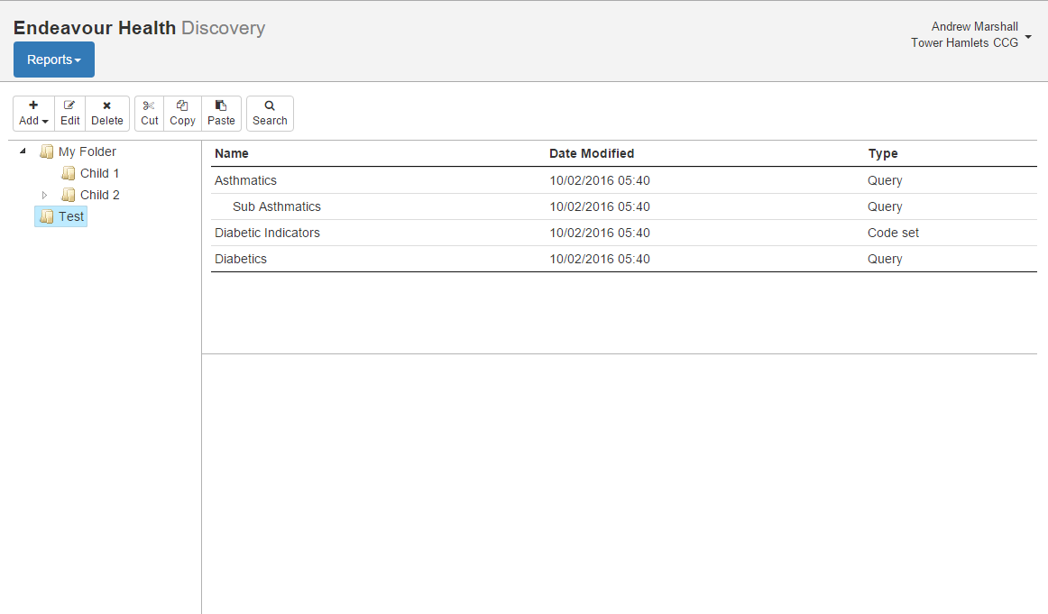

Name
Modified
Last Run
Child Diabetes Review | 02/12/2015
Diabetic Review | 19/12/2015 | 19/12/2015
QOF 2015 | 01/11/2014
Run Date
Status
Parameters
Results
20/12/2015 | Scheduled
20/12/2015 | Scheduled
19/12/2015 | Complete
05/12/2015 | Complete
Baseline date: 19/12/2015
Patient status: Active only
Organisations (15): North London

Slide 7

Name
Modified
Last Run
Child Diabetes Review | 02/12/2015
Diabetic Review | 19/12/2015 | 19/12/2015
QOF 2015 | 01/11/2014
Run Date
Status
Parameters
Results
20/12/2015 | Scheduled
20/12/2015 | Scheduled
19/12/2015 | Complete
05/12/2015 | Complete
Name
Population | 150,620
Diabetics | 9,320 (6%)
Over 50 | 5,306 (73%)
Amputation | 103 (2%)
Decreasing BP | 290 (4%)

Slide 8
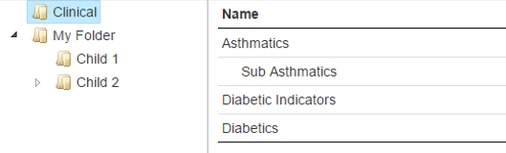
Report Editor
Diabetic Review
Source
Report
Diabetics
Over 50
Amputation
Decreasing BP
Recent Diabetics
All medication

